Slide 1
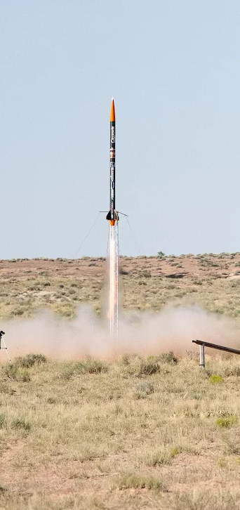
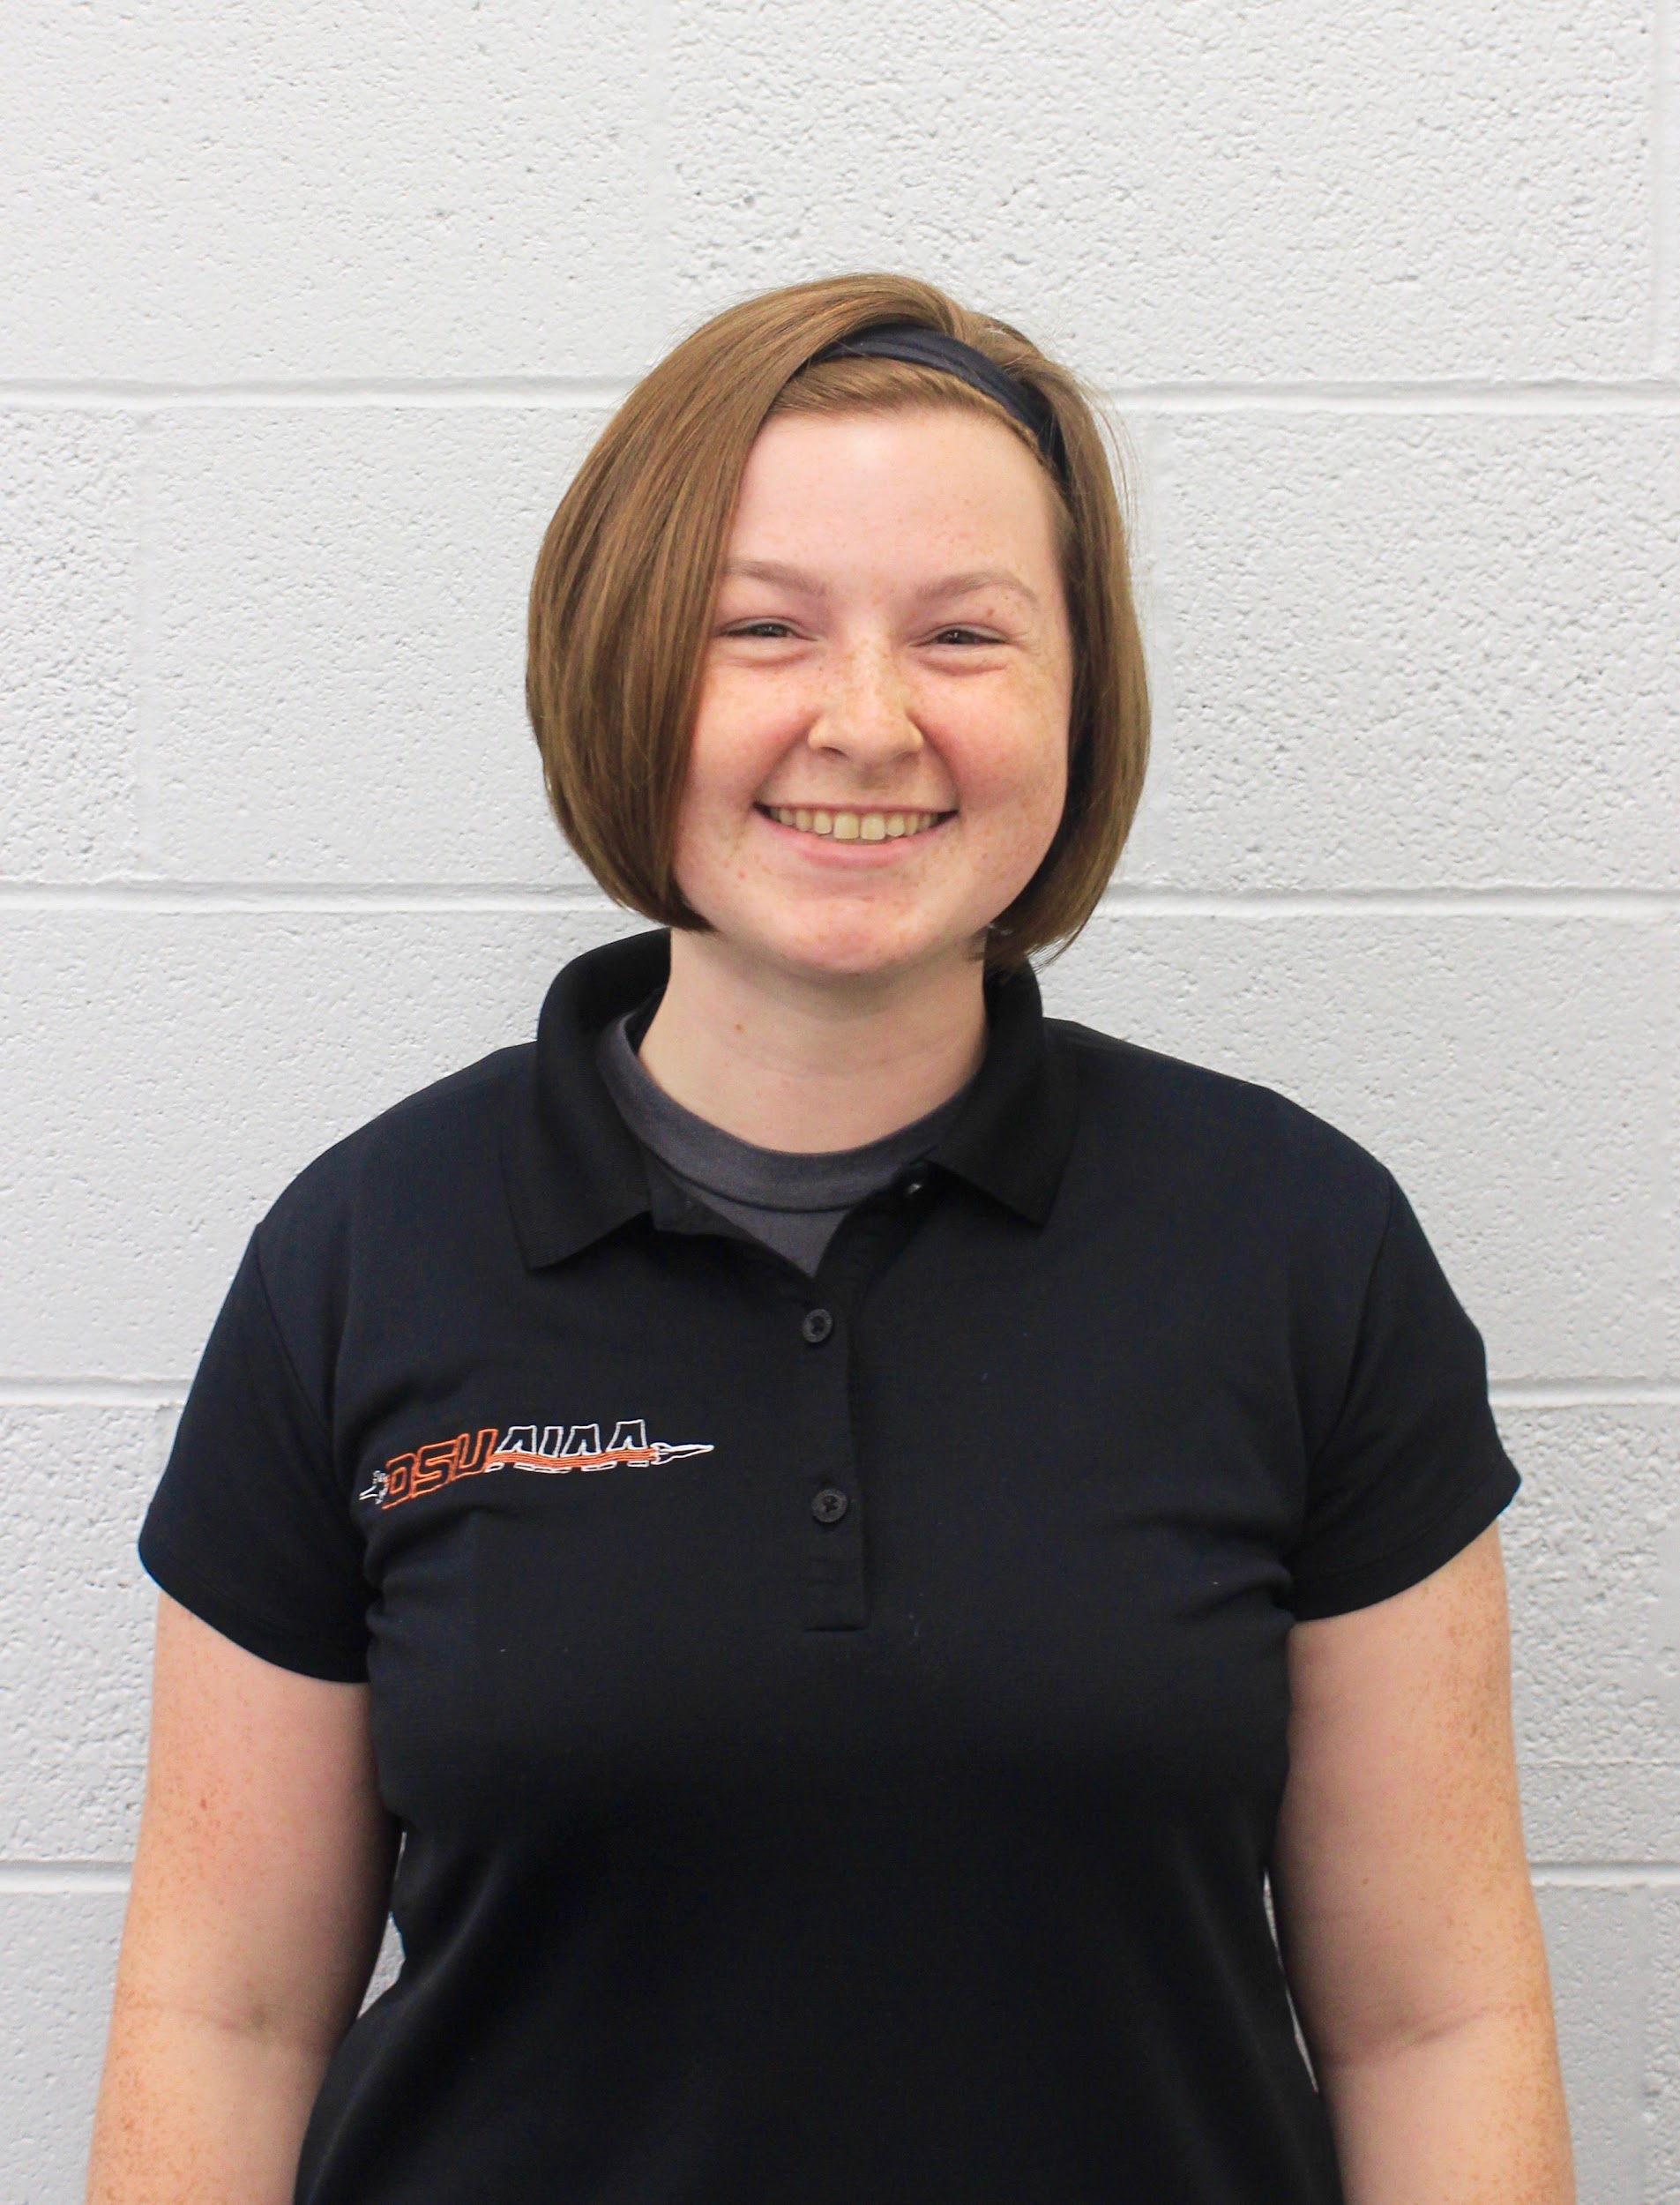

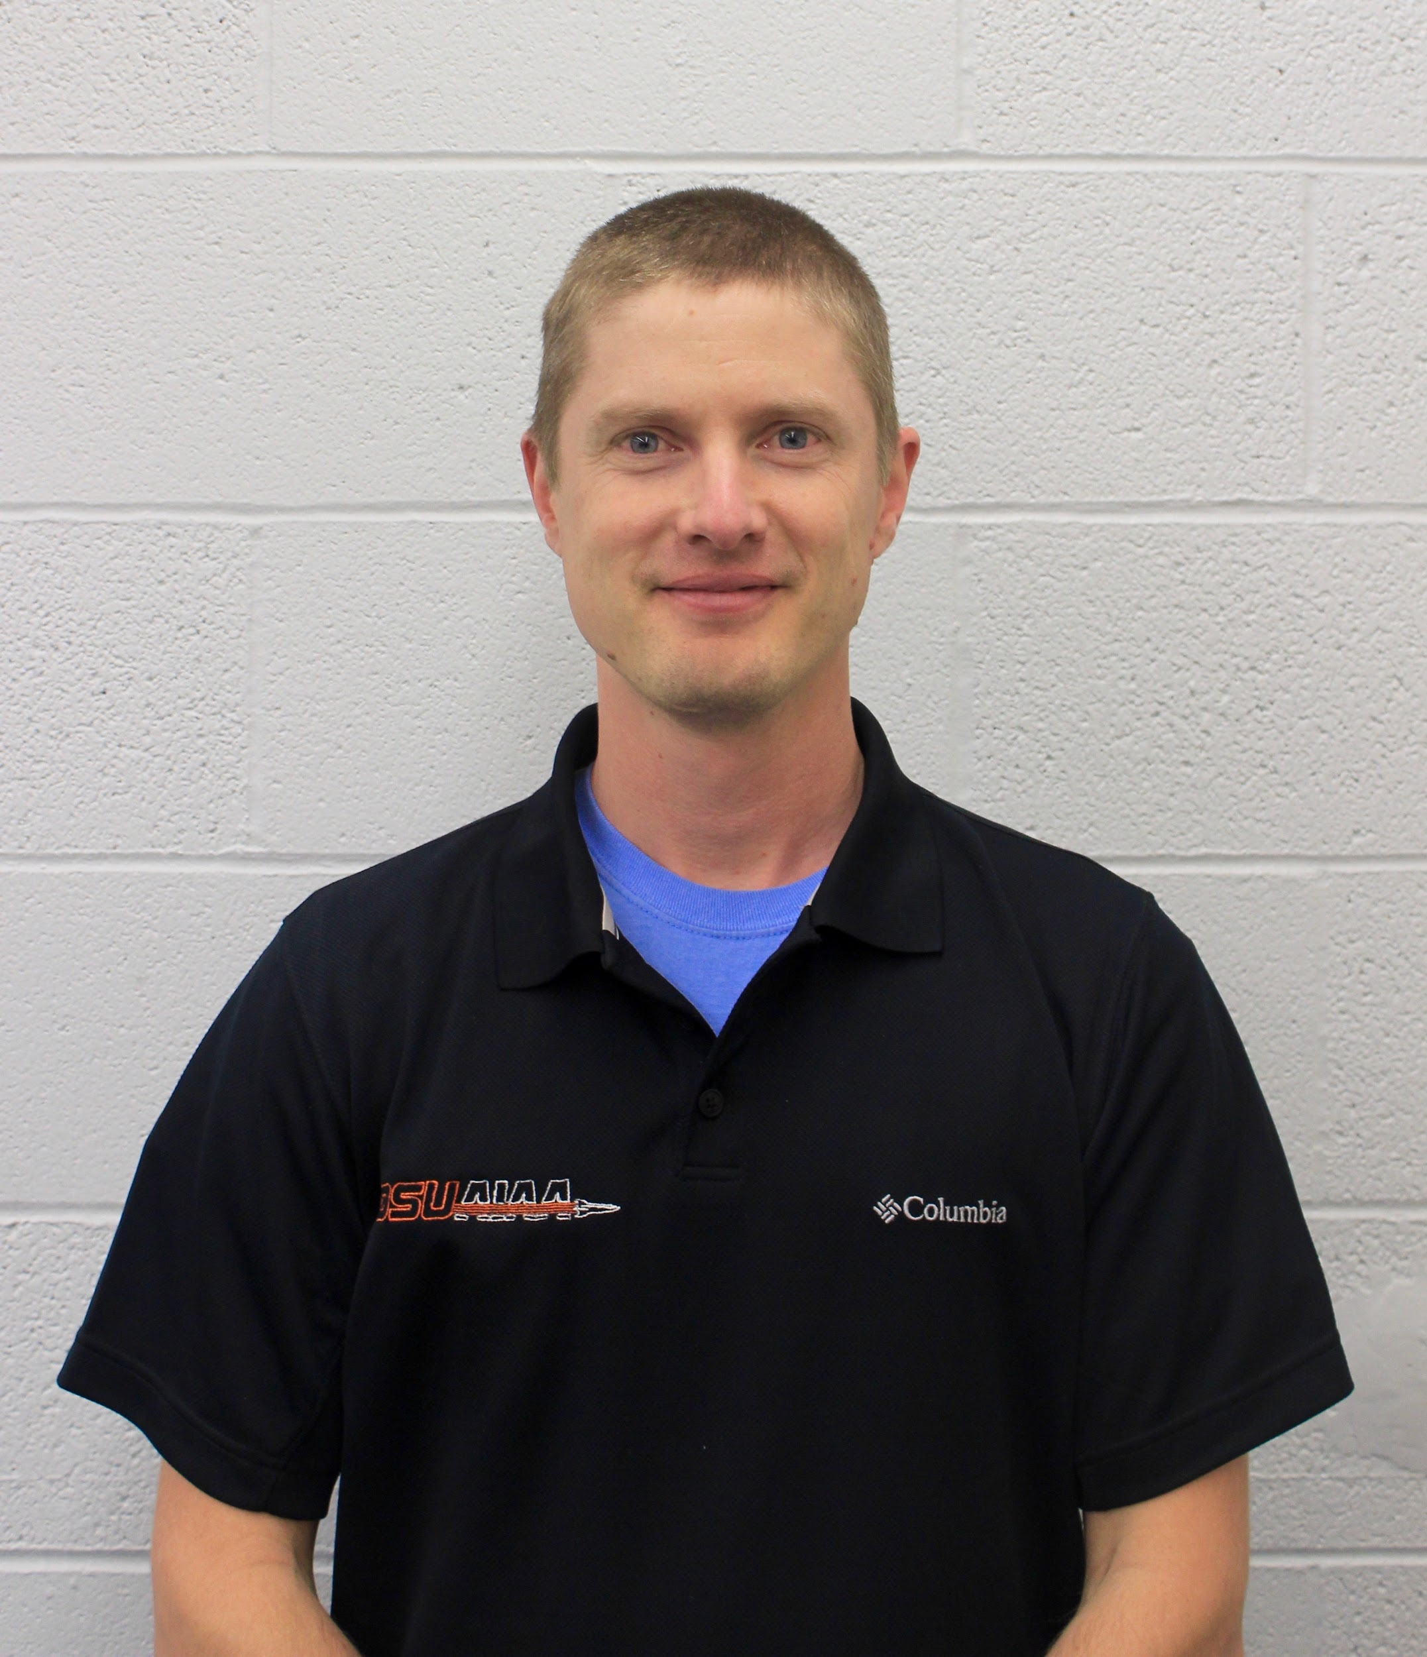
Team 41 Winter Progress Report
30k Spaceport America Cup 2017-18
Notes:
All of us

Slide 2
Overview
Software and ground station components for the 2018 Spaceport America Cup 30K Challenge
Our mission is to write flight avionics for both a rocket and scientific payload, as well as design a ground station capable of receiving and displaying live telemetry data from the rocket.

Slide 3
Project Goals
This project can be (greatly) simplified to three primary goals:
Design a ground station to receive and display flight data.
Write payload avionics to control a scientific experiment.
Write rocket avionics to log kinematics and detect apogee.

Slide 4
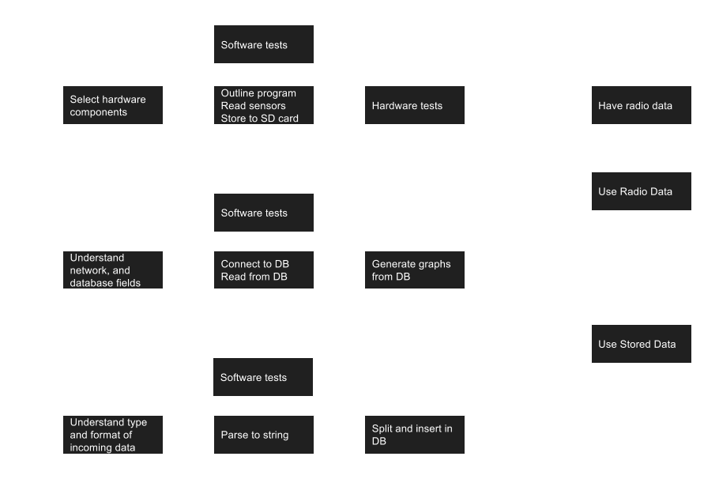
Development Roadmap
End of Fall Progress
Mid Winter Term Progress

Slide 5
Ground Station
Physical build and components
Raspberry Pi 3B:
Create ad-hoc WiFi network
Host MariaDB database
Serve NodeJS website with flight data
Raspberry Pi Zero (4):
Parse incoming telemetry data

Slide 6
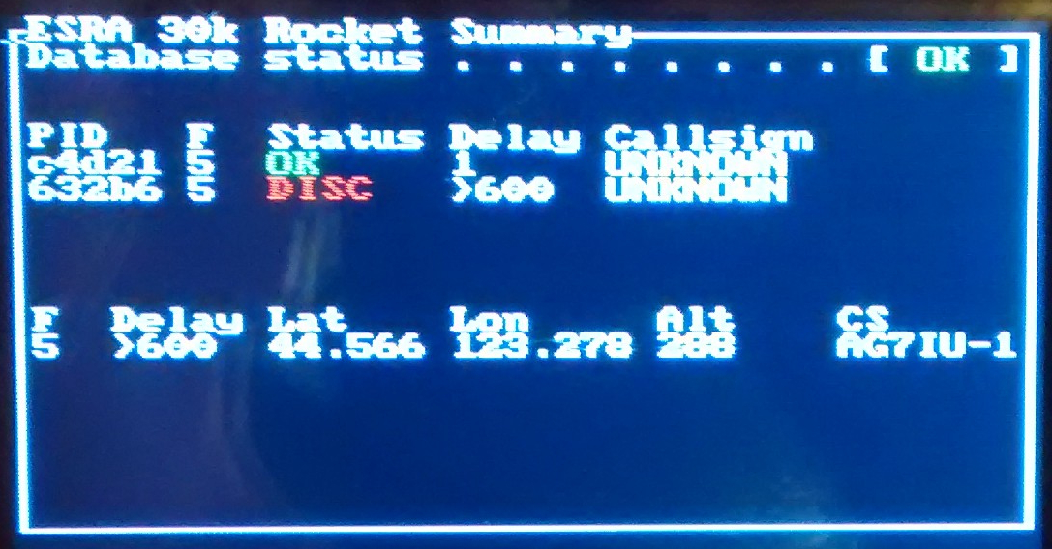
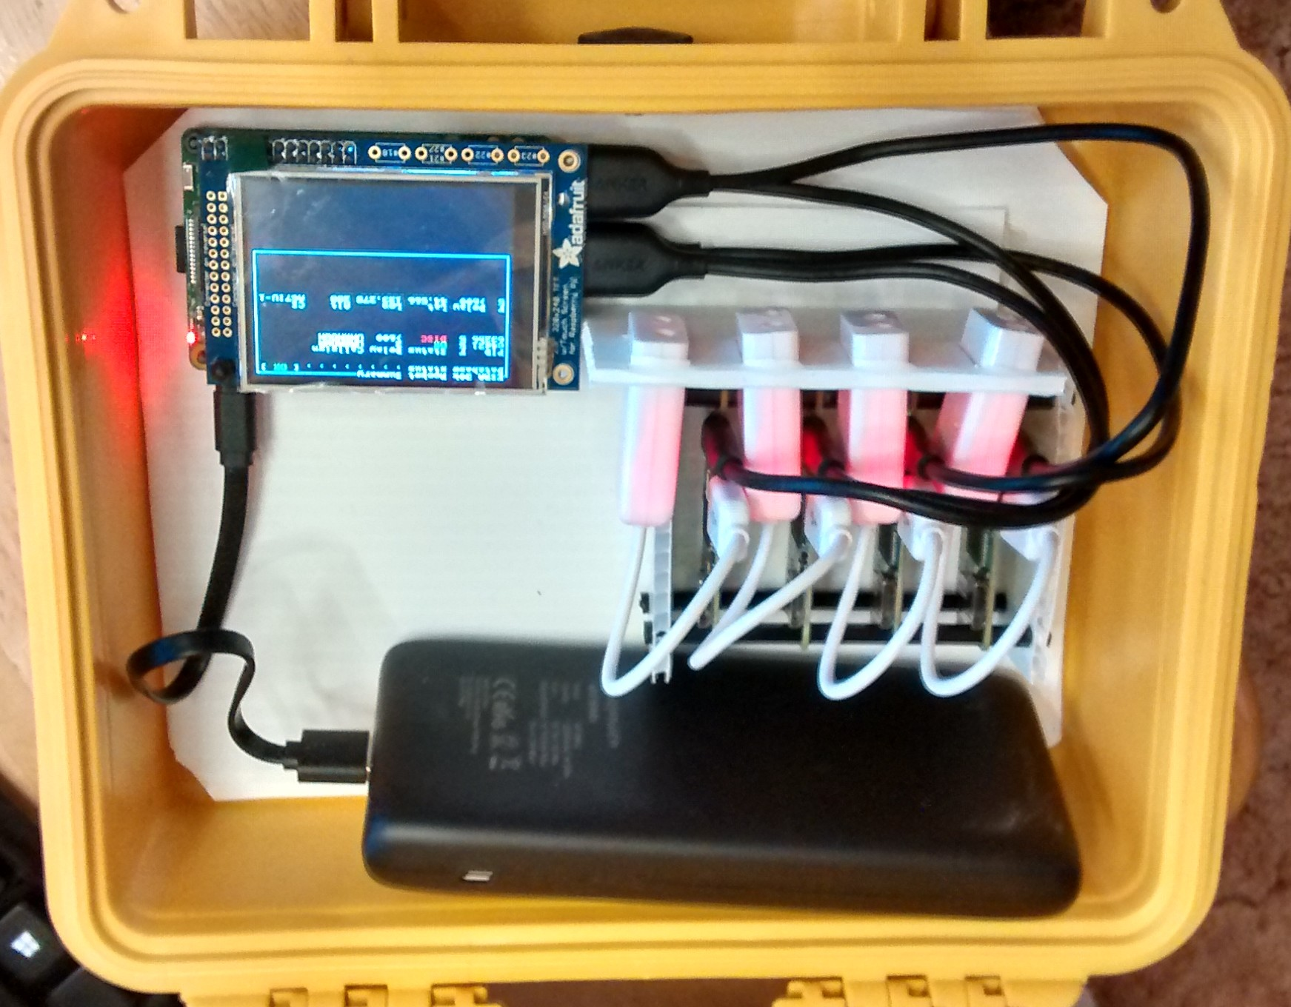
Ground Station
The physical build includes:
1 - 8”x10”x6” yellow case
1 - Raspberry Pi B3
4 - Raspberry Pi Zero W
4 - USB sound cards
1 - 2.7” LCD Display
1 - 22,000 mAh rechargeable battery
Notes:
Levi

Slide 7
Ground Station - Database
The MariaDB database stores data from sources including:
Flight logs from both avionics programs
BeelineGPS and TeleMega telemetry units
Parsing computers
Error logs
Notes:
Levi

Slide 8
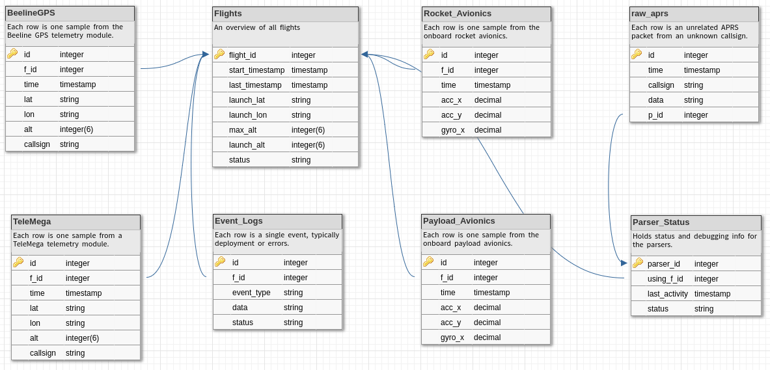
Ground Station - Database
Notes:
Levi

Slide 9
Ground Station - Parsers
The ground station includes 4 Raspberry Pi Zeros:
Each Zero listens to a single radio frequency
Completed one end-to-end test using radio TX and RX
Range tests performed using audio recorded by ECE subteam
Performance comparable to COTS hardware decoders
Notes:
Levi

Slide 10
Ground Station - Parsers
All Zeros use identical SD cards
The cpu serial number uniquely identifies each Zero in the DB
All Zeros run headless, the parsing program is a daemon
Minimal text output, writes directly to database
Notes:
Levi

Slide 11
Ground Station - Networking
Networking:
Using USB OTG to connect the Pi zeros to the main Pi 3B
Main Raspberry Pi serves a Wi-Fi Network
Works for testing
Stress test revealed issues
Notes:
Allison

Slide 12
Ground Station - NodeJS
NodeJS website:
Served by our main Raspberry pi 3
A GUI for our graphs and flight data
Implemented using express-handlebars
Makes frequent queries to the database
Notes:
Allison

Slide 13
Ground Station - Display
Graphs Overview
Query database
Use CanvasJS
Update every second
Can take inputs from numerous sources
Notes:
Joshua

Slide 14
Ground Station - Display
Line Graphs
Altitude vs Time and Vertical Velocity
Use CanvasJS
Use any number of sources
Based on Flight ID

Slide 15
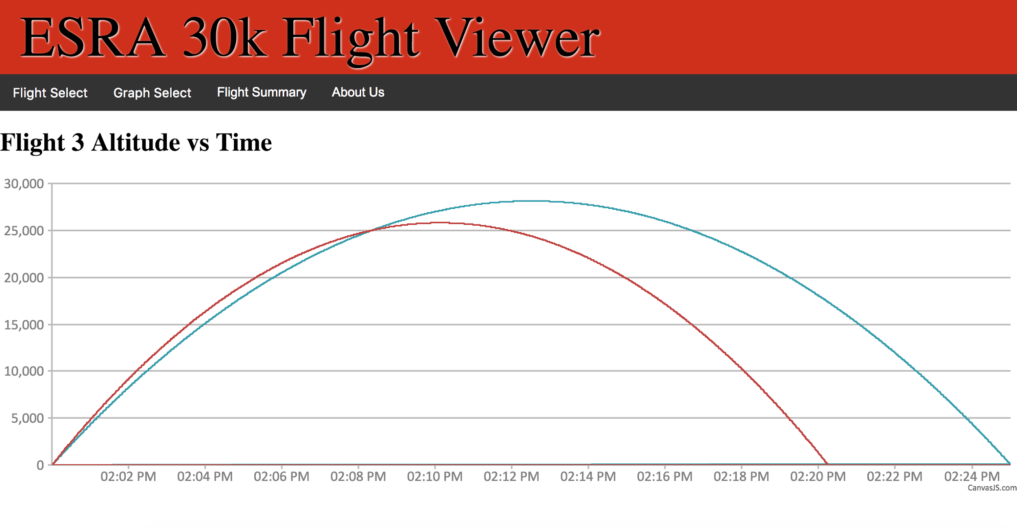
Ground Station - Display

Slide 16
Ground Station - Display
Map
GPS coordinate
Calculate location based on map
Any number of sources
Based on Flight ID

Slide 17
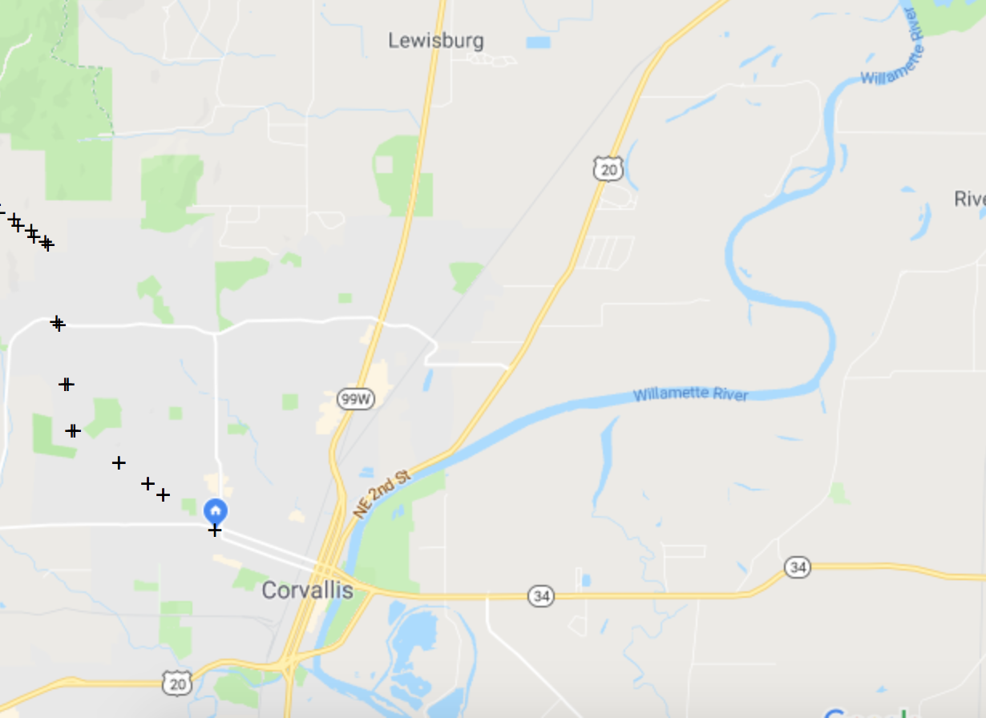
Ground Station - Display

Slide 18
Ground Station - Display
Planned Features
Use image for map
Change color for map
Acceleration graph
True velocity/acceleration graphs
Altitude or time in map

Slide 19
Sensor Avionics
Sensors Currently Implemented
MPU - Accelerometer
BMP - Altimeter (will not be used)
MPL - Altimeter
HMC - Magnetometer (may not be utilized)
Not Implemented
Real Time Clock

Slide 20
Sensor Avionics
Speed Issues
Bus is a significant speed barrier, language is not
Most sensor update at less than 1khz
Writing speed not heavily affected by opening and closing, further testing may be done

Slide 21
Payload Avionics
Our goal is to create 10-12 seconds of zero acceleration for a scientific experiment inside the payload. Payload avionics record sensors on the payload as it descends.
10” propeller and motor will reduce drag from air resistance.
Counterweight motor will reduce rotational forces.
Notes:
Levi

Slide 22
Payload Avionics
The avionics loop currently:
Reads 22 values from several sensors
Calculates motor speed using PID loop
Controls motor with a PWM output
Logs data to CSV file
Notes:
Levi

Slide 23
Rocket Avionics
Overview
Very similar implementation to payload avionics
Read and log sensor values
Detect apogee
Notes:
Allison?

Slide 24
Rocket Avionics
Apogee Detection
Mission critical task
Can’t detect too early or too late
Not being used for competition
Notes:
Allison?

Slide 25
Rocket Avionics
Apogee Sensors
Magnetometer is common in commercial applications
Possible Interference from metal
Using altitude and acceleration data together will be more reliable
Notes:
Allison?

Slide 26
Rocket Avionics
If (total acceleration <= somewhat close to zero g’s) Start a countdown timer. If apogee hasn’t been logged when it goes off, log apogee event. If (total acceleration <= very close to zero g’s) Start a much shorter countdown timer. If apogee hasn’t been logged when it goes off, log
apogee event. If (altitude begins to decrease) Log apogee event If (total acceleration hits one of our thresholds and then starts to increase again) Apogee has occurred. If it hasn’t been logged, log it now.
Notes:
Allison?

Slide 27
Conclusions
Notes:
All of us?

